Slide 1


Zagazig University
Faculty of Engineering
Computer Systems Engineering Dept.
software-defined networking ( SDN )
prepared by
Mostafa Elsayed Gohary
present to
DR : Nesreen I. Ziedan

Slide 2
Outline
Befor SDN
Why SDN
How SDN work
SDN applications
SDN advantages
SDN controllers
Demo

Slide 3
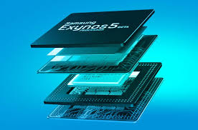
The power of abstraction
How hardware abstraction was useful

Slide 4
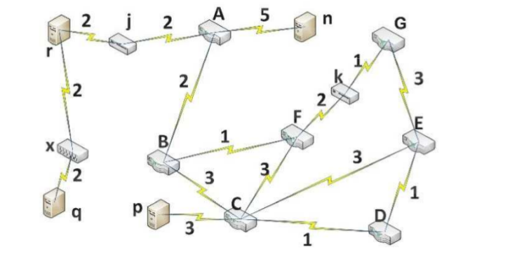
How network work

Slide 5
Where the problem ?
-Don’t have top view of all network.
-Difficult to manage the traffic and make the load balance.
-Difficult to discover and diagnose when things go wrong.
-Don’t have the flexibility
-Different vendors

Slide 6
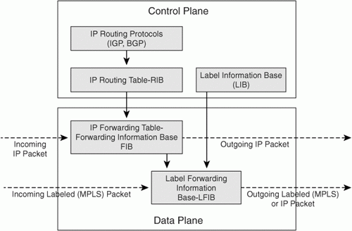
How network work

Slide 7
Control plane VS Data plane
Control plane
Makes decisions about how handling traffic on the network
Control plane functions :
- System configuration .
- System management .
- How routers exchange the routing table information .
Data plane
Forwards traffic according to
decisions that made by the
control plane

Slide 8
Now what is the SDN
Software-Defined Networking ( SDN )
-By SDN we can separate between the control plane and
the forwarding plane(data plane) .
-SDN provide a good soluation to control the network by
programming and make abstraction for the
applications and network services from the nature of the
network topology .

Slide 9
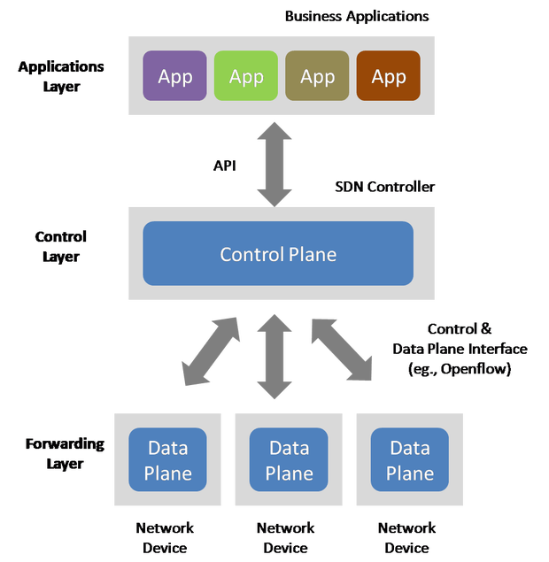
The SDN architecture

Slide 10
The SDN architecture
The Controllers : It’s consider as th “brains” of the network SDN Controllers offer a centralized view of the overall network .
the network administrators can to dictate to the underlying systems (like switches and routers) how the forwarding plane should handle network traffic.
Southbound APIs: SDN uses southbound APIs to relay information to the routers and switches ‘ below ‘ , and use the Openflow protocal to communicates with this routers and switches
Northbound APIs: SDN uses it to communicates with the applications ‘above’ ,so the network administrators can easily program the shape traffic and deploy services.

Slide 11


The Openflow
Openflow was created in 2008 at Stanford university
Now the Open Networking Foundation (ONF) manage OpenFlow specification and how adopt with SDN

Slide 12
The Openflow
- First standard communications protocol that interface defined between the control and forwarding layers of an SDN architecture.
- Openflow protocol enables the SDN Controller to directly interacting with the forwarding behaviors of switches from different vendors on condition these switches provide a API for dealing with openflow protocol .
- When SDN controller make a decision such that change the switch/router
flow table Openflow provide a interface from the controller to the switch

Slide 13
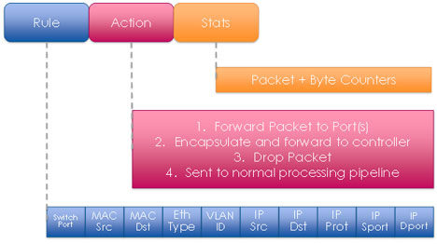
The Openflow

Slide 14
Openflow Benefits
Centralization
- more performance optimization .
-top overview of the whole network topology .
Programmability
- Enable the programers to make more
Innovative and different applications in
less time .
- Administrators don’t neet to deal with CLI (commmand line interface) or other configuration interfaces the can directly control the data plane by openflow interface .
Abstraction
- control plane and the data plane .
- software and hardware .
-logical and physical configuration .

Slide 15
SDN Applications
1- Data Centers
2- Enterprise Networks
3-Internet Exchange Points ( IXPS )
4-Home Networks

Slide 16
SDN advantages
1-Centralized Management : it is can be so easily to control and mange the traffic and make Balance loads ,track and debug the errors andmaintenance it .
2- Agility and Flexibility : helps organizations fastly deploy new services , applications,, and infrastructure so quickly meet business goals and objectives.
3- Innovation : help the researchers to develop new applications and services .
4- Indenpendent : develop sofwares that will manage the network independence from the hardware.

Slide 17
SDN advantages
5- Research : help to do experments on the network easily and fastly .
6- Security : by centralized control it is can alongside a multi-layered security strategy to deal with increasing threats.
7- Vendor dependence : help to deal with different devices from different vendors .

Slide 18
Network Functions Virtualization (NFV)
offers a new way to design, deploy and manage networking services.
NFV decouples the network functions, such as network address translation (NAT), firewalling, intrusion detection, domain name service (DNS), and caching, to name a few, from proprietary hardware appliances so they can run in software.

Slide 19
Network Functions Virtualization (NFV)
It’s designed to consolidate and deliver the networking components needed to support a fully virtualized infrastructure – including ( virtual servers, storage, and even other networks).
It utilizes standard IT virtualization technologies that run on high-volume service, switch and storage hardware to virtualize network functions. It is applicable to any data plane processing or control plane function in both wired and wireless network infrastructures.

Slide 20
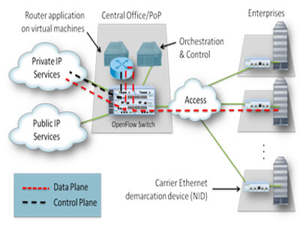
Network Functions Virtualization (NFV)

Slide 21
SDN VS NFV
SDN
enables users to program network layers, separating the data plane from the control plane
NVF
allows for agile placement of networking services when and where they are needed. By enabling this level of programmability

Slide 22
SDN VS NFV
SDN and NFV can enable users to optimize their network resources, increase network agility, service innovation, accelerate service time-to-market, extract business intelligence and ultimately enable dynamic, service-driven virtual networks.

Slide 23
SDN Controllers
SDN Controller : a software-defined network (SDN) are the brains of the network. It is the application that acts as strategic control point in the SDN network, manage flow control to the switches/routers ‘below’ (via southbound APIs) and the applications and business logic ‘above’ (via northbound APIs) to deploy intelligent networks .

Slide 24

1- NOX
- It is the first-generation SDN controller
- initially developed by “Nicira Neworks”
- open source
- created in 2008
- there are two edition of NOX
- classic NOX : written in c++ and python no longer supported
- new NOX : written in c++ anly fast ,stable

Slide 25
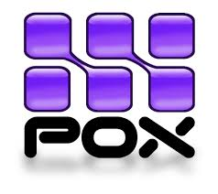
2- POX
- python based controller
-supports the same GUI and visualization tools as NOX
Pox algorithm for a switch :
1- update address/ ports table
2- if multicast ,flood
3-if no table entry ,flood
4-if source == destination ,drop
5-install flow table entry

Slide 26
3-FLOODLIGHT
- Open-source SDN Controller
- Java based controller
- Allows developers to create SDN applications
-Supports OpenFlow protocol
-Apache-licensed

Slide 27
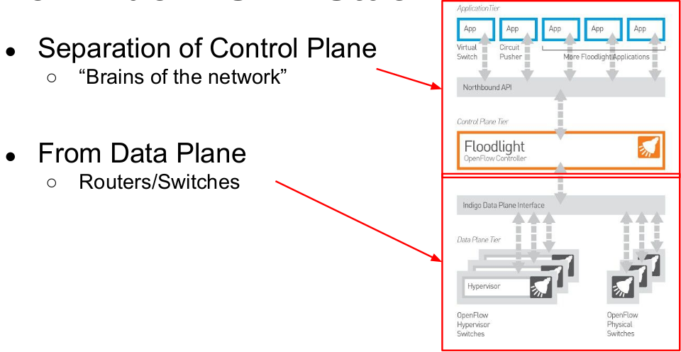
3-FLOODLIGHT
3-FLOODLIGHT 3-FLOODLIGHT

Slide 28
3-FLOODLIGHT
Basic functions :
1- install/Remove forwarding rules on switches
- route flows along the correct path
- Flows are packets with same header
2-Topology Discovery
- know what the network looks like
- Link Layer Discovery Protocol
3-Statistics
- know what is happening in the network and what the traffic is

Slide 29

OpenDaylight Project
- founded by The Linux Foundation On April 8, 2013
- written in Java.
- it’s goal to accelerate the adoption of software-defined networking (SDN)
-has many releases
-Hydrogen February 2014 - Helium October 2014
-Lithium June 2015 - Beryllium February 2016

Slide 30






OpenDaylight Project
THE PLATINIM MEMBERS

Slide 31


OpenDaylight Project
THE GOLDEN MEMBERS

Slide 32












OpenDaylight Project
SOME OF SILVER MEMBERS

Slide 33
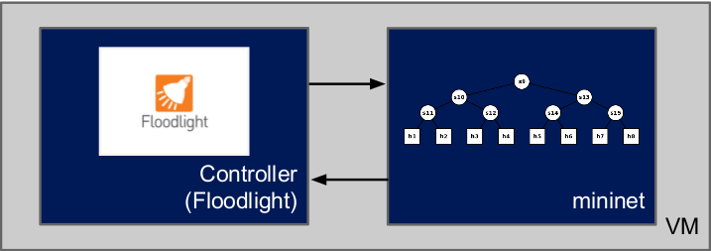
The mininet
-Mininet is a network prototyping tool
-Simulate an entire network on your pc
-Design network topology
-Testing the topology

Slide 34
The mininet
Examples
sudo mn
nodes
dump
net
iperf
h1 ifconfig
h1 ping h1
sudo mn -c
sudo mn --link tc,bw=100,delay=10ms

Slide 35
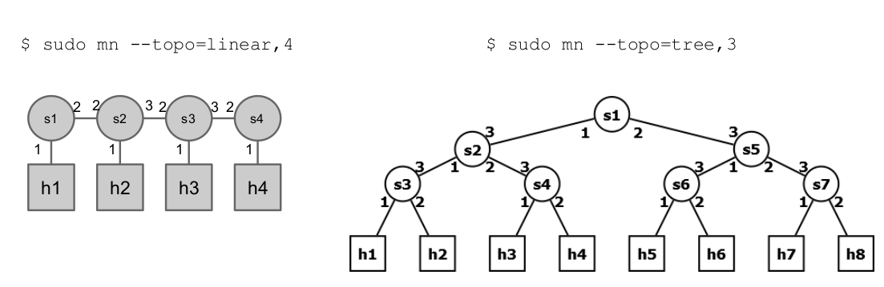
The mininet
Examples

Slide 36
NO QUESTIONS
THANKS

